Slide 1
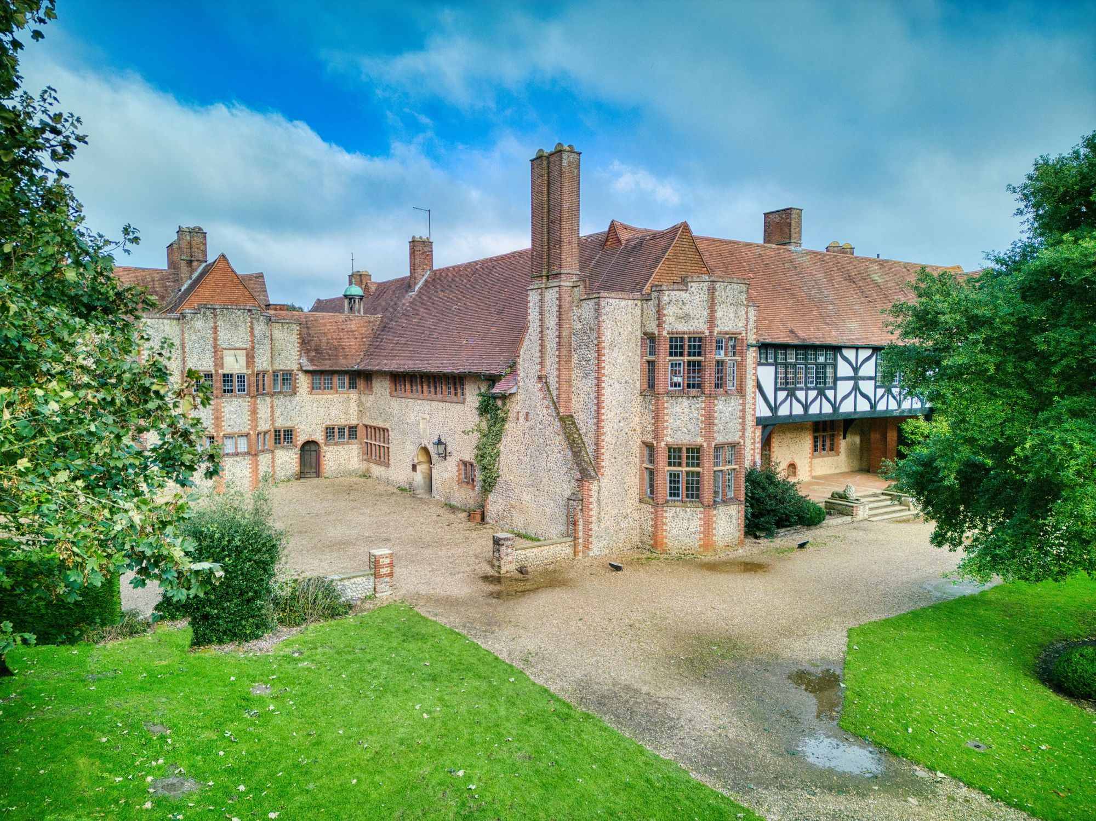
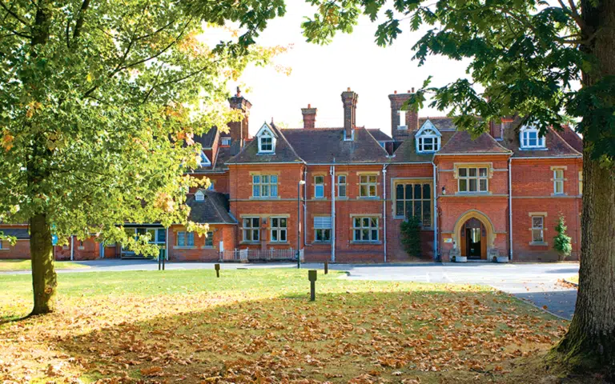
Year 6 Residential Trip
Grosvenor Hall, Kent
Mon 5th – Fri 9th October 2026
https://vimeo.com/106273922?fl=pl&fe=sh

Slide 2
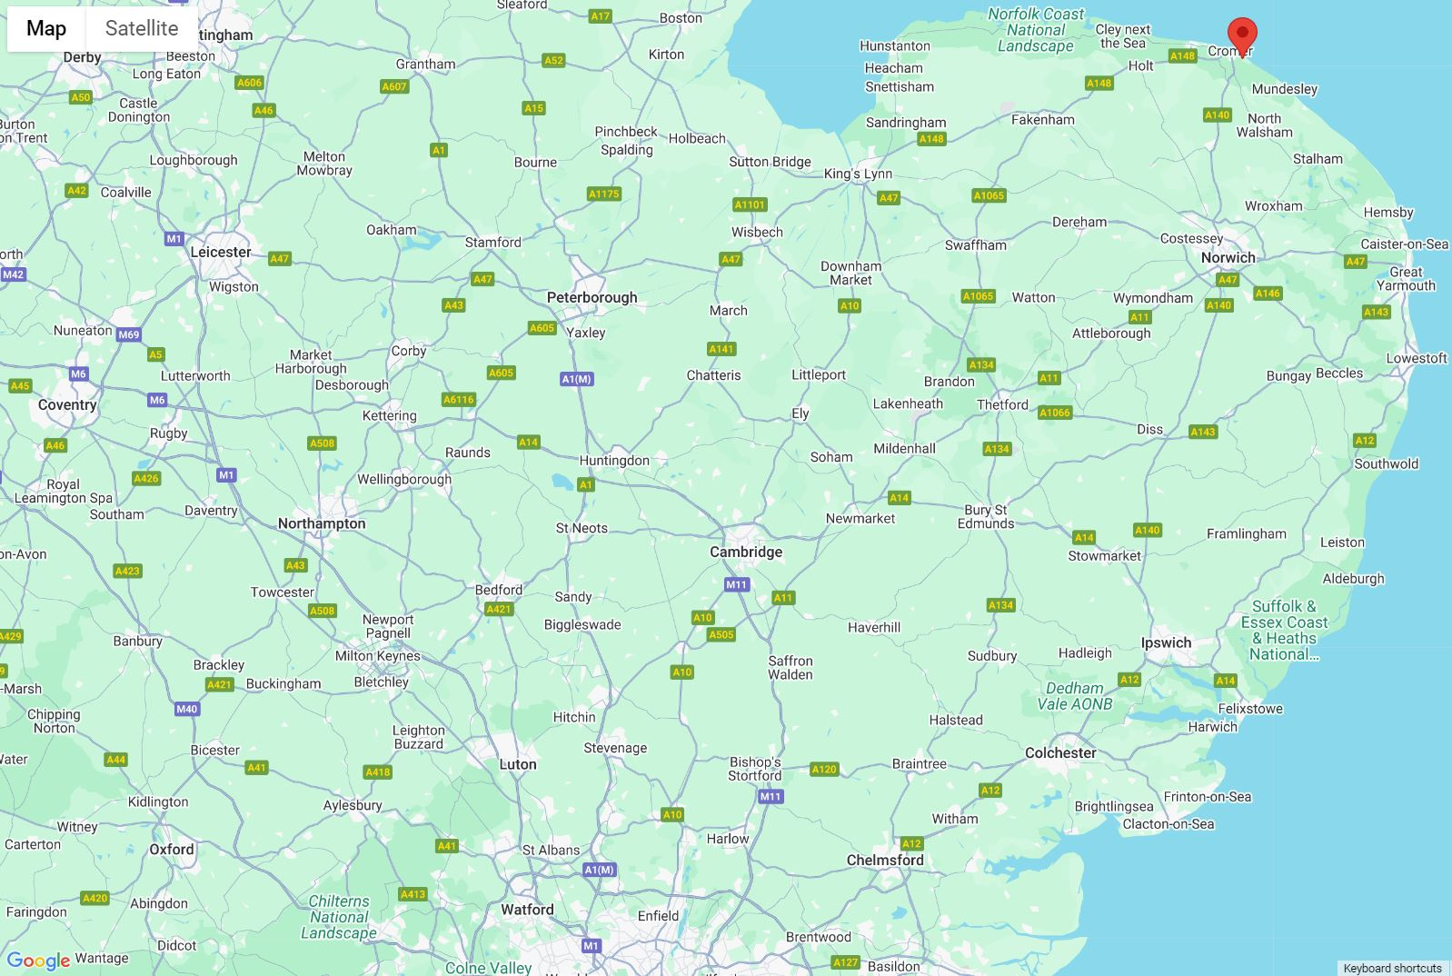
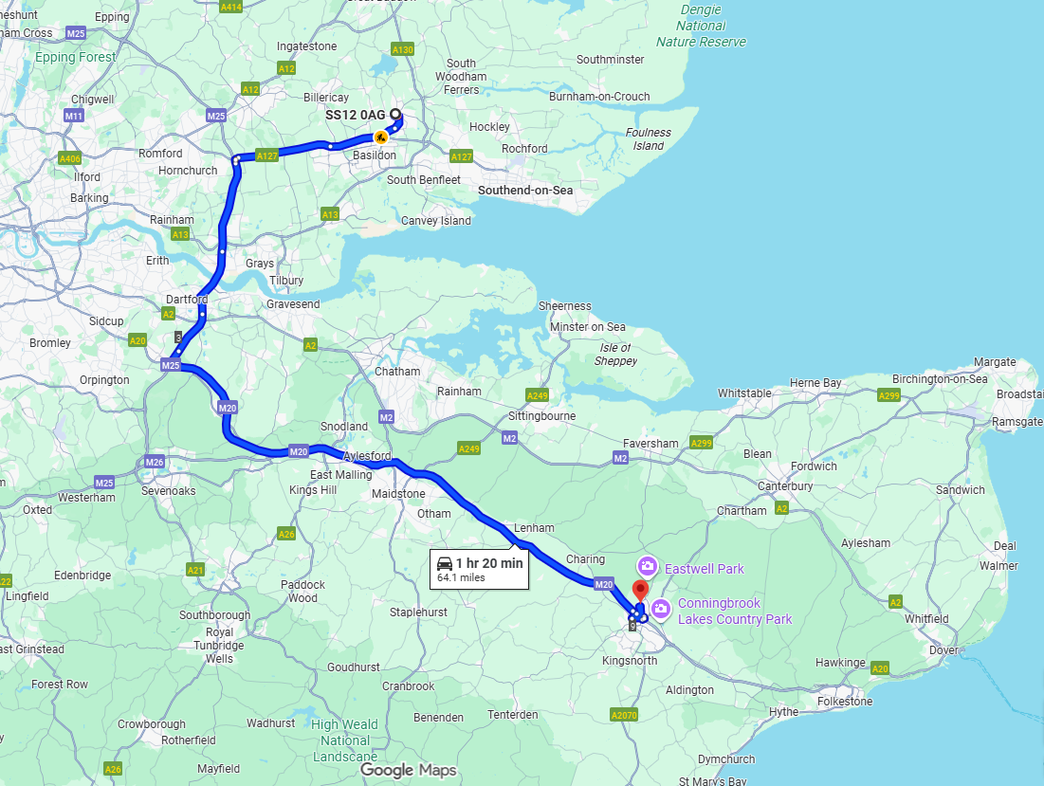

1 hour 30 mins

Slide 3
What your child can expect
To learn a lot about themselves.
Develop their social skills.
New things and find new interests that they might not find at school or at other clubs.
A fantastic way to make memories that will last.
To become more confident.
See our previous trips here.

Slide 4
Itinerary
Monday – leave school. Medical items.
Arrival, tour of site, unpack, fire drill.
3 activities on the first day.
Three hot meals a day.
5 group activities each day plus an evening activity. Timetable available the week before.
Friday – leave after lunch. Return to school around 4pm (weather permitting).

Slide 5
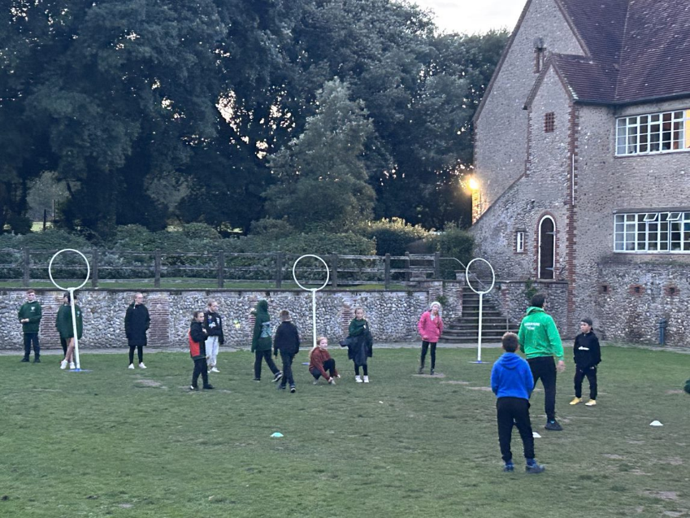
The activities we’ll be doing.
Beach Adventure
Buggy Build
Bushcraft Shelter Building
Bushcraft Fire Lighting
Caving
Climbing
Fencing
Get Connected
High Equilibrium
Jacob's Ladder
Leap of Faith
Low Ropes
Nightline
Orienteering
Problem Solving
Quidditch
Scavenger Hunt

Slide 6
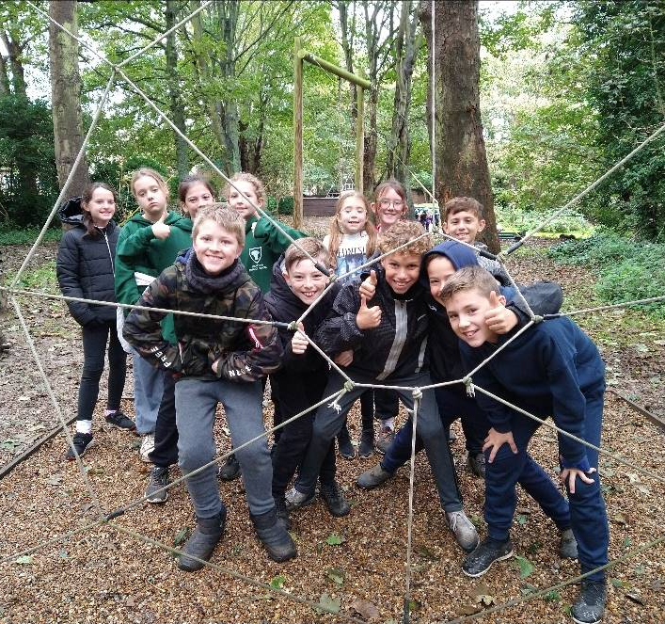
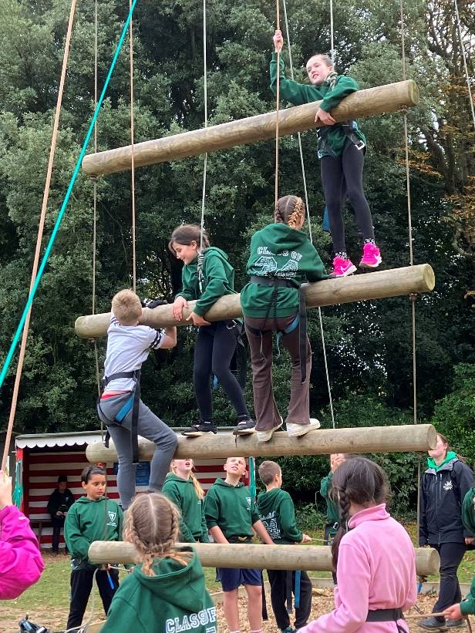
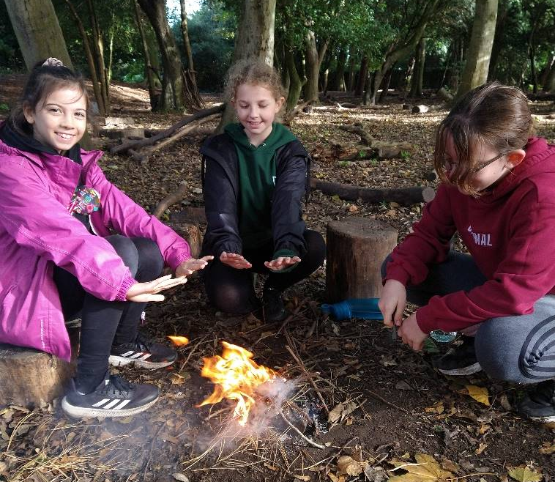
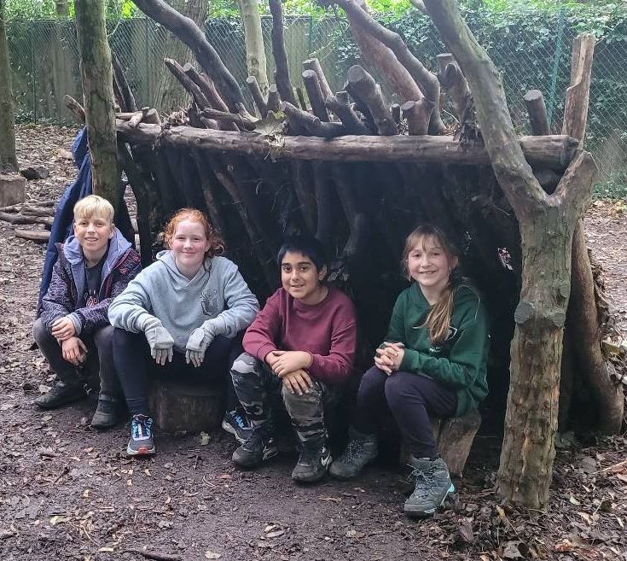
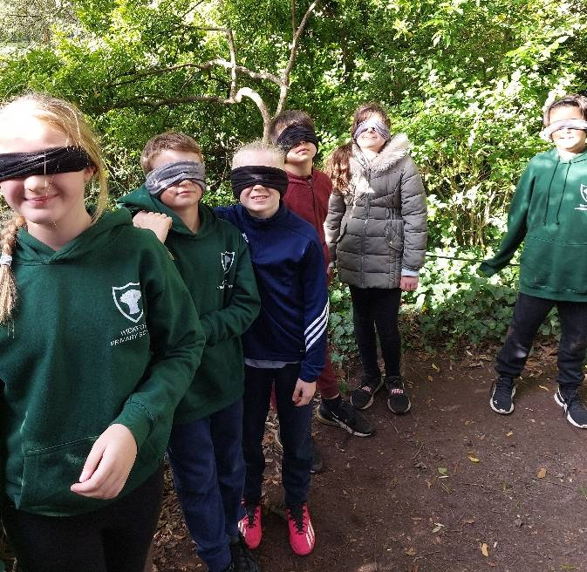
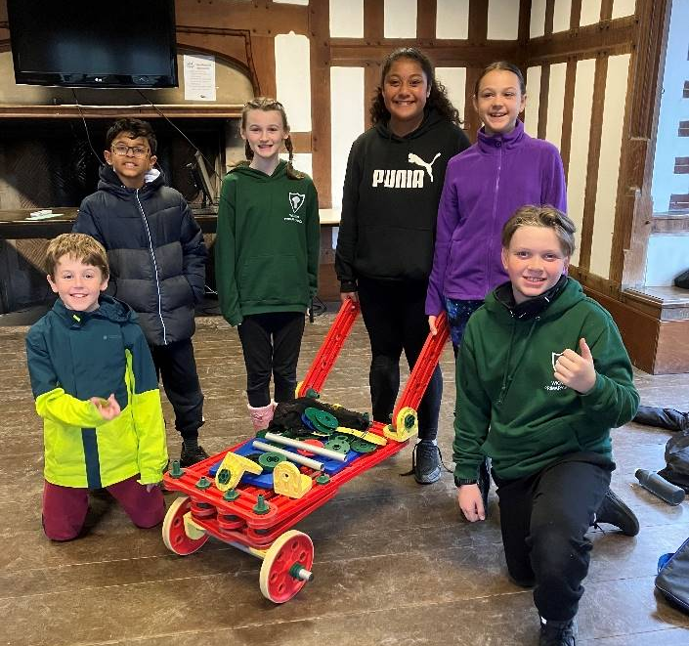
Previous
Trips

Slide 7
Day Groups
A few weeks before we leave, the WPS staff members choose day groups and group leaders.
We mix all three classes and friendships.
There are between 13-15 children in each group.

Slide 8
Accommodation
Children will write down a few children they would like to share a dorm with.
Dorms will be organised taking this into consideration.
Other factors such as: other friendship issues, medical needs, and the dorm sizes will determine who is in each dorm.
Girls and boys are in separate wings.

Slide 9
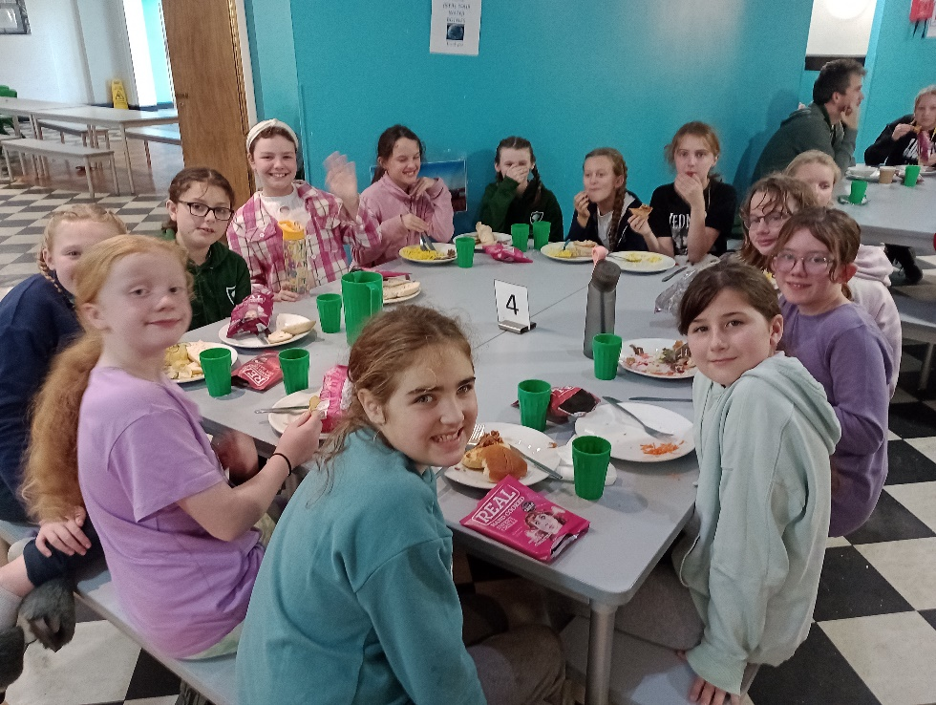
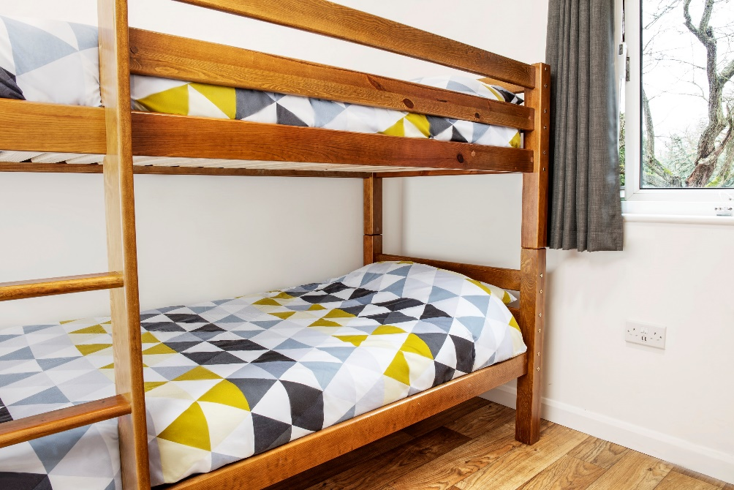

Slide 10
Safety
Each group is lead by a WPS staff member.
All activities have been risk assessed.
All activities are led by at least one Kingswood-trained staff with WPS staff member present.
At the start of every activity, there is a health and safety talk.
All the instructors hold nationally recognised qualifications and the children will be provided with the necessary protective clothing for all activities.

Slide 11
Safety
The entire site is protected by security fencing and entry is restricted by security gates.
All adults on centre, wear high-visibility identification badges.
Staff are trained to challenge anyone who is not in possession of a security pass.
Staff rooms are identified to the children and there are experienced medical staff on site 24 hours a day.
First aid trained staff members and medical room. All incidents are reported and seen by WPS staff member.

Slide 12
Safety & Communication
Medical forms completed in advance.
Parents have an emergency number should you need to contact us.
Texts will sent on arrival and departure.
The website is updated and daily texts.

Slide 13
Summary
Date: Monday 5th – Friday 9th October 2026
Cost: £435
Deposit £60 by 21st November 2025.
Remaining balance of £375 in instalments:
  £60 by 1st December ’25
  £60 by 1st January ‘26
  £50 by 1st February’26
  £50 by 1st March ‘26
  £50 by 1st April ‘26
  £50 by 1st May ‘26
  £55 by 1st June ‘26

Slide 14
Frequently Asked Questions

Slide 15
What will my child need to bring?
What if my child is unwell whilst away?
Can the children bring their mobile phone?
Can the children bring other electronics e.g. DS, iPad, tablet etc?
What if my child gets homesick?
What if I need to get in touch with my child or a staff member on the residential?
What if it is my child’s birthday?
A full kit list has already been sent home. This has been uploaded to the website as well.
This will depend on the severity. They will be well looked after and you will be contacted if necessary.
No. Being without home comforts is part of the experience.
See answer to Q4
We will look after them. They won’t be the first. – just let an adult know.
We can be contacted by the school office in case of any emergencies.
In previous years, we have taken cakes (provided by parents) and celebrated it whilst away.

Slide 16
Any Other Questions?

